Slide 1

Understanding & Communicating Risk
A Discussion Guide for the NCDHHS Fall 2023 Covid Vaccine Booster Campaign

Slide 2

What is the best way to encourage someone to consider a risk and act to reduce it?
Decades of research exist to help firms, public policy agencies, and other organizations understand how consumers respond to risk information and design more effective communication campaigns.
Unfortunately, it is spread across numerous fields and is difficult to find, integrate, and use.
The goal of this discussion is to use the interdisciplinary Seven I’s framework to discuss how we talk to people about Covid vaccine boosters.

Slide 3
Seven I’s Framework: How Consumers Pragmatically Respond to Risk Information
When we share risk information with people, we know that they can do many things with that information.
Ignore
Interrogate
Inform
Identify
Influence
Implement
Intend
We worry the information will be ignored.
These are the Seven I’s
We hope that the call to action will be implemented.
But it can often feel like a roulette wheel in terms of what actually happens.

Slide 4
What are the Seven I’s?
The Seven I’s | Definition
Ignore | People do not notice or attend to your risk information
Interrogate | People ask questions about your risk information
Inform | People change their beliefs (are informed by) your risk information
Identity | People have a facet of their identity invoked by your risk information
Intention | People form a general or specific plan to act about your risk information
Implement | People follow through on their intention and act on your risk information
Influence | People share with others to encourage them to act on your risk information
How can you use the Seven I’s Framework to understand how people think about the Covid Vaccine Booster and encourage them to implement expert recommendations?

Slide 5
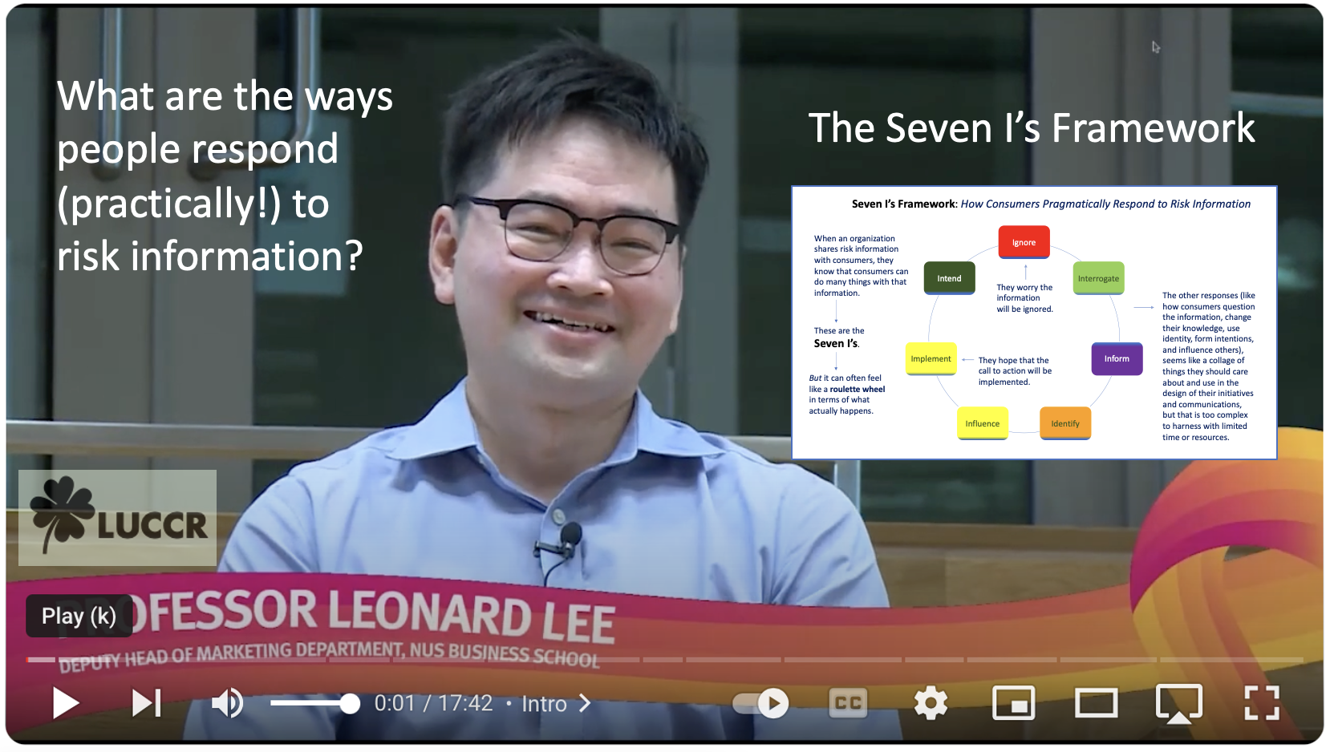
Here is a brief video to explain the Seven I’s Framework
While you watch, consider:
What causes our risk information to be ignored?
Do different people we try to reach have different reasons for ignoring the information?
What are some of the things we hope people will do with our information (i.e., what intentions do we want them to implement?)

Slide 6
The Basic Seven I’s Framework

Slide 7
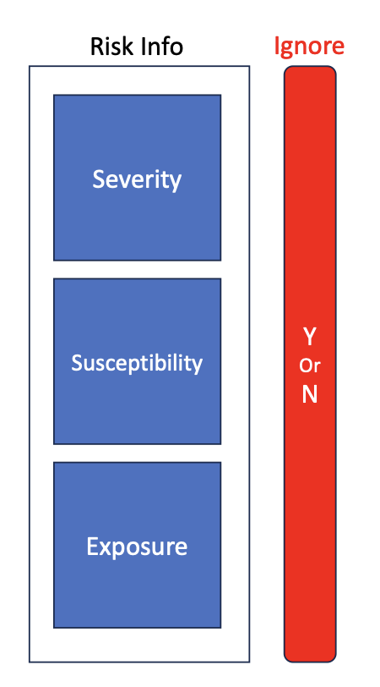
FIRST, risk information has three components that can help jump the IGNORE barrier…
Severity
How serious is the consequence if the risk is realized?
Example: Skin cancer from sun exposure requires serious medical attention and can be fatal in some cases.
Susceptibility
How likely is any particular individual to be harmed by the risk?
Example: Individuals with fair skin or who had early childhood sunburns are most susceptible to sun-based skin cancers.
Exposure
How prevalent is the risk in the community?
Example: Sun exposure is highest for high-altitude locations, in outdoor workforces (like farming or construction), and areas where the ozone layer is damaged.

Slide 8
The 3 risk components now for Covid vaccine boosters
Severity: The new Eris variant
There is a greater risk of long Covid, but lower risk of death (Information from the notes box)
Susceptibility: It depends where you live
Urban areas are experiencing growing numbers, but do people in rural areas notice?
People may ignore increasing cases if they have ‘Covid Fatigue’ and don’t look at headlines
Exposure: Nationally Covid cases are rising
Which of these can we focus on to make sure people don’t ignore our risk information?

Slide 9

SECOND, consider how people INTERROGATE risk information.
Here people have issues that they address by considering information from different sources.

Slide 10
Interrogate: Covid vaccine boosters
ISSUES People Think About
Side effects of vaccine adding up
Is it really necessary?
Isolating is a big cost but is it needed
Does it cost money now?
Questions to consider:
Which of the sources do people go to for the different issues?
Sources People Trust for this
Personal doctor
Some friends
Some internet sites
Politicians
Do any of these sources provide misinformation?

Slide 11
Interrogate
Watch these four short videos to hear about each concept
There are many ways that people question the risk information they receive in order to see if it matters to them.
Here, it’s important to consider the following concepts:
Source credibility
Trust
The Persuasion Knowledge Model
The Elaboration Likelihood Model
Source Credibility
Trust
Persuasion Knowledge Model
Elaboration Likelihood Model

Slide 12
THIRD, we seek to INFORM
Does our risk information actually inform people, i.e. change their prior beliefs?
Do we really need our risk information to inform people or are we only seeking to remind people of what they already know?
If we seek to inform, there are several concepts that we can consider to help facilitate that process
Objective versus Subjective Knowledge
Learning and memory
INFORM:
Knowledge, Learning, and Memory

Slide 13
Inform: Covid Vaccine Boosters
Objective Knowledge: Low
Subjective Knowledge:
High
When people know less than they think they do, our message needs to signal that a new look is needed.
To engage deeper learning, we can:
Prompt people to want to seem informed (be an expert)
Encourage people that learning will yield benefits to others
Use emotional appeals to motivate elaboration & memory

Slide 14
FOURTH, we consider how people IDENTIFY with our risk information
Often messages about risk information triggers different aspects of a person’s identity.
This is especially important when the action we are advocating is public (versus private) or when our population is very diverse.
Here we consider concepts like:
Segmentation
Bem’s Self-Perception Theory
Uniqueness Neglect
Trust & source similarity
Considering IDENTITY

Slide 15
Identify: Covid Vaccine Boosters
Vaccine boosters are private actions
Vaccine boosters do trigger aspects of identity
Our population differs in terms of
Age
Culture
Income
Education
Questions to consider:
Is there a narrative or logic that supports each identity segment in acting as we advocate?
Can we use a source similar to each of our different segments in our messages?

Slide 16
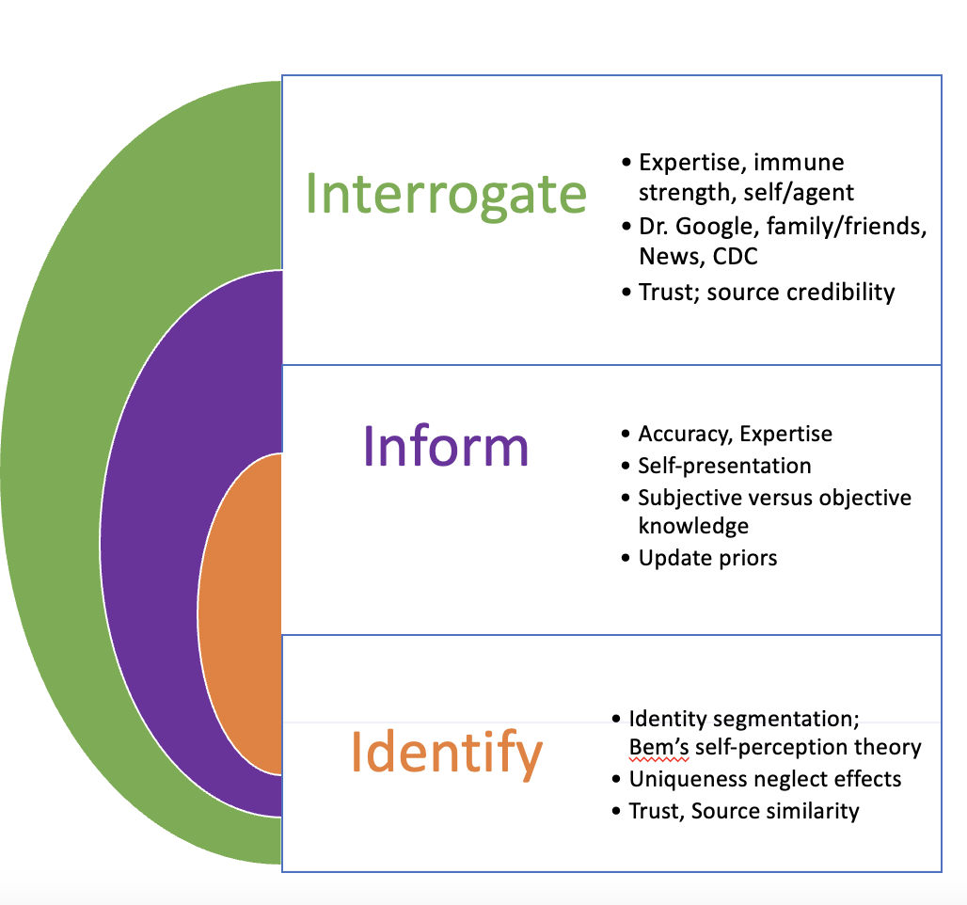
Thus, the processing of our risk information looks like this:

Slide 17

FINALLY, we hope to move people to action → INTEND, IMPLEMENT, & INFLUENCE
For example, if we were advocating the use of sunblock to mitigate skin cancer risk, we would hope our message recipients would:
Make a plan to buy sunblock
Look at sunblock brands
Buy sunblock
Make a plan to put it on every morning
Keep the sunblock bottle in sight on their bathroom sink
Put on the sunblock
Potentially reapply sunblock
Mention their use of sunblock to others
Advocate or encourage others to use sunblock
Apply sunblock on their children
Remind partners to apply sunblock

Slide 18
Intend: Best practices to encourage intentions
Best practices to encourage intentions

Slide 19
Implement: Best practices to encourage implementation
Best practices to encourage implementation

Slide 20
Influence: Best practices to encourage influencing
Best practices to encourage influencing

Slide 21
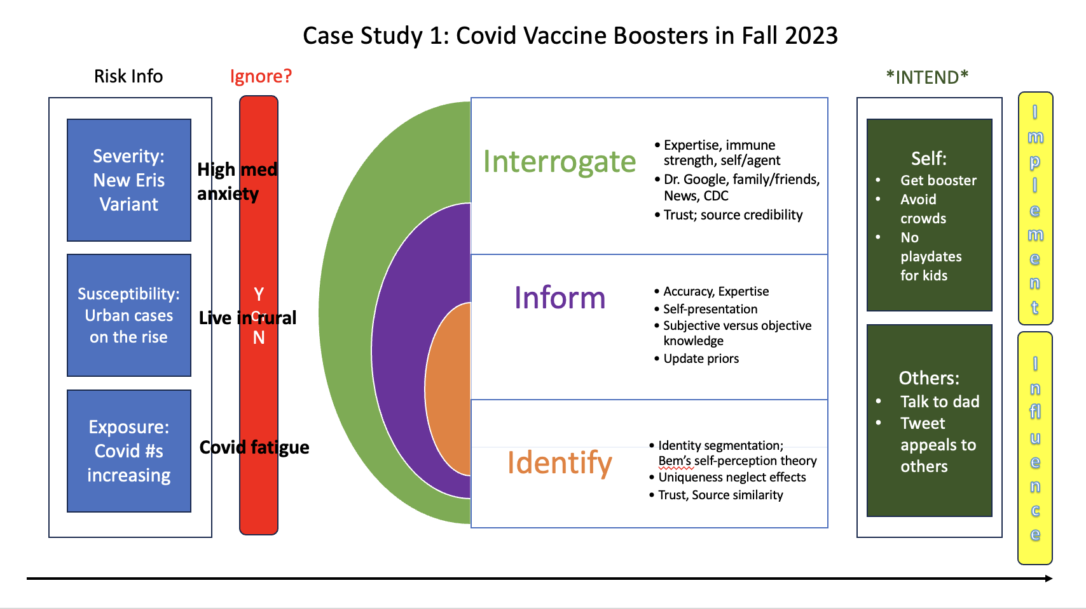
Putting it all together! We can see how all our elements work together to increase our message efficacy.

